Slide 1
Defensive Security Project
by: Nickolas Garcia, Tony Ayala,
Erik Bjella, Brendan Boynton,
Ifedapo Ebiesuwa

Slide 2
Table of Contents
This document contains the following resources:
Monitoring Environment
Attack Analysis
Project Summary & Future Mitigations

Slide 3

Monitoring Environment
‹#›

Slide 4
Scenario
Employed by VSI: A virtual reality company for business.
Job title: SOC analyst (5)
Nickolas Garcia, Erik Bjella, Brendan Boyton, Ife Ebiesuwa and Tony Ayala
There have been rumors of a potential cyber attack on VSI. The suspected actors belong to long time rival JobeCorp.
Use Splunk to create active monitors that will alert us of potential attacks against the company systems and applications.

Slide 5
Parallel Coordinates add-on
‹#›

Slide 6
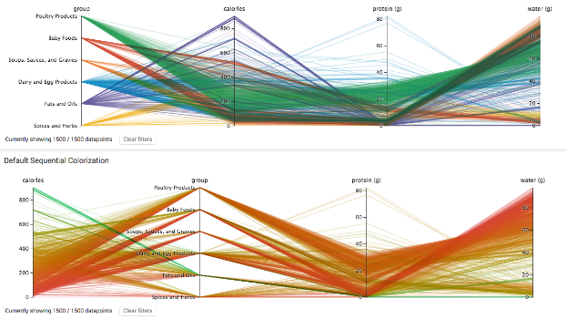
“Parallel Coordinates”
Parallel coordinates are used to depict relationships in multi-dimensional datasets. This visualization is ideal for comparing many variables together and seeing the relationships between them. Each variable is given its own axis and corresponding scale. Lines then map item values for each variable. The ordering of axes can help discover patterns or correlations across variables.

Slide 7
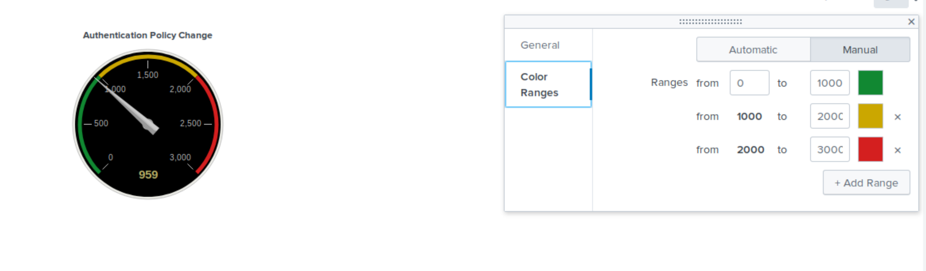
Radial Gauge
With Radial Gauge, we are able to add an interactive visualization to data. In this example, you see that the acceptable range for Authentication Policy Changes peaks at 1000, while anything concerning ranges up to 2000, and finally a presumed intentional attack would be marked beyond.

Slide 8
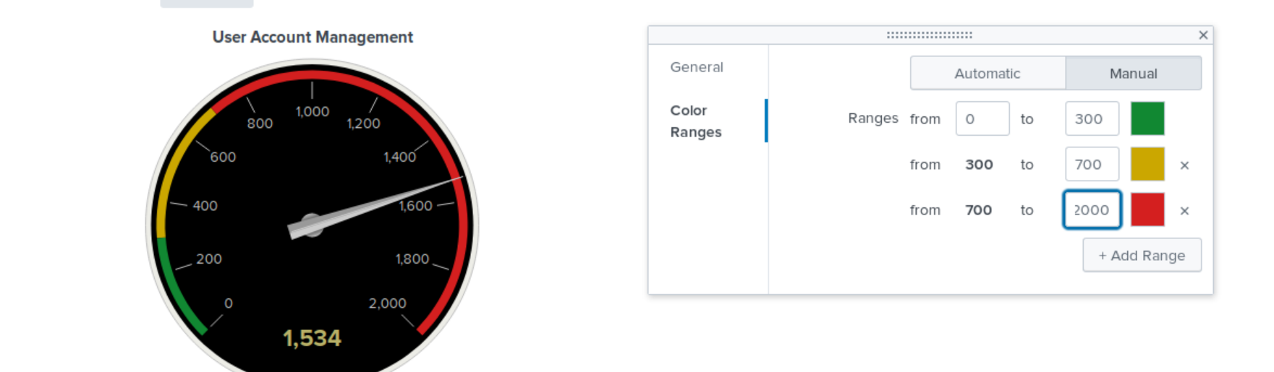
Radial Gauge cont’d

Slide 9


Logs Analyzed
Windows Logs
Apache Logs
1
2
These logs contain data points for normal business operations via Windows. The logs given to us represented normal behavior. This was used to create baselines for our monitoring system.
We were then given logs that simulated potential attack activity.
These logs contain data points for normal business operations via Apache. Apache is the web server that processes requests and serves assets and content via HTTP. The logs given to us represented normal behavior. This was used to create baselines for our monitoring system.
We were then given logs that simulated potential attack activity.

Slide 10
Windows Logs
‹#›

Slide 11
Reports—Windows
Designed the following Reports:
Report Name | Report Description
Windows Server Monitoring, Sig Counts | This report serves as an indicator of what actions users are taking specifically and how many of that action have taken place in a given time frame.
Windows Server Monitoring, Severity Levels | This monitors the amount of alerts, as well as the severity levels of those alerts based on if they are high risk or informational.
Windows Server Monitoring, Windows Activity | This report counts the amount of failed or successful activities taken on the windows Server, to help indicate possible brute force attacks.

Slide 12
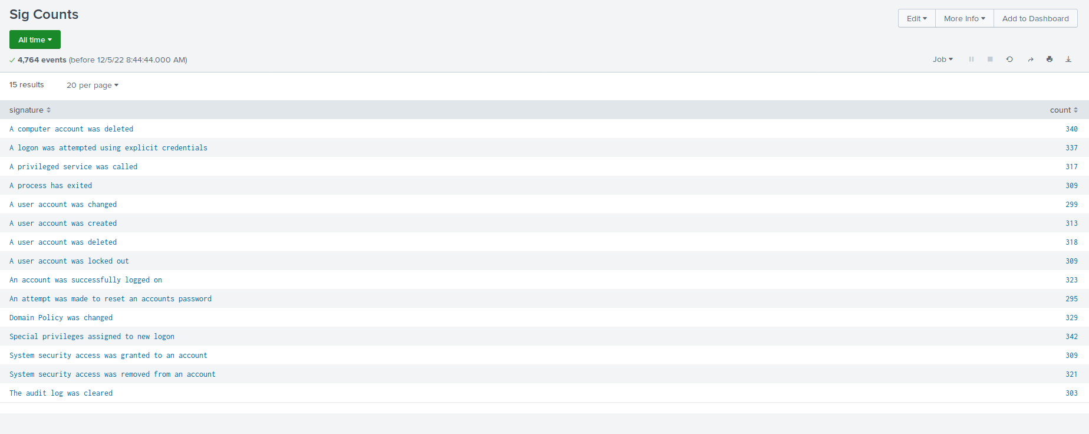
Images of Reports—Windows

Slide 13
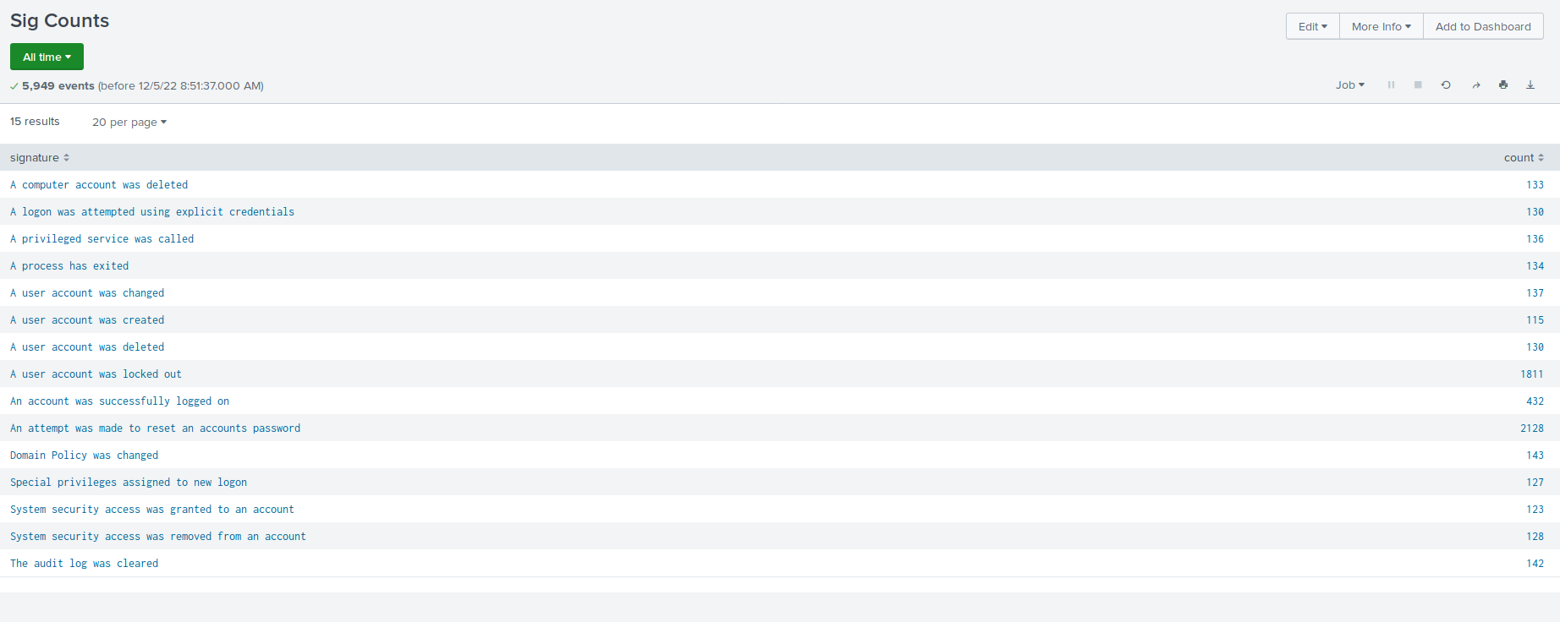
Images of Reports—Windows

Slide 14
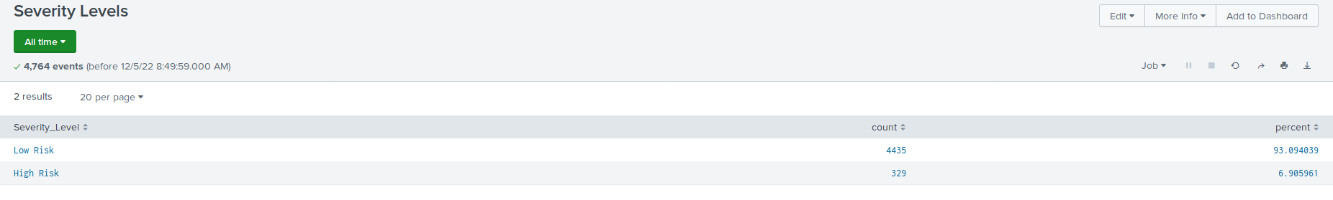
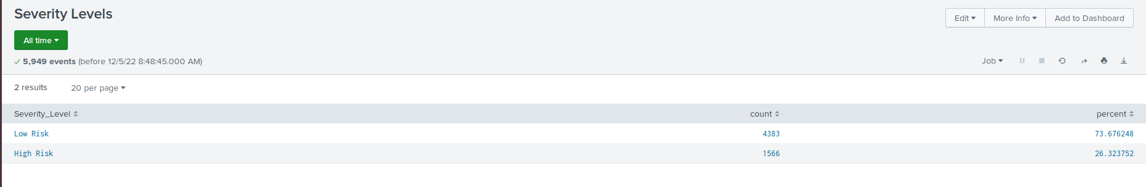
Images of Reports—Windows

Slide 15
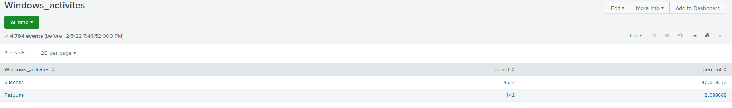
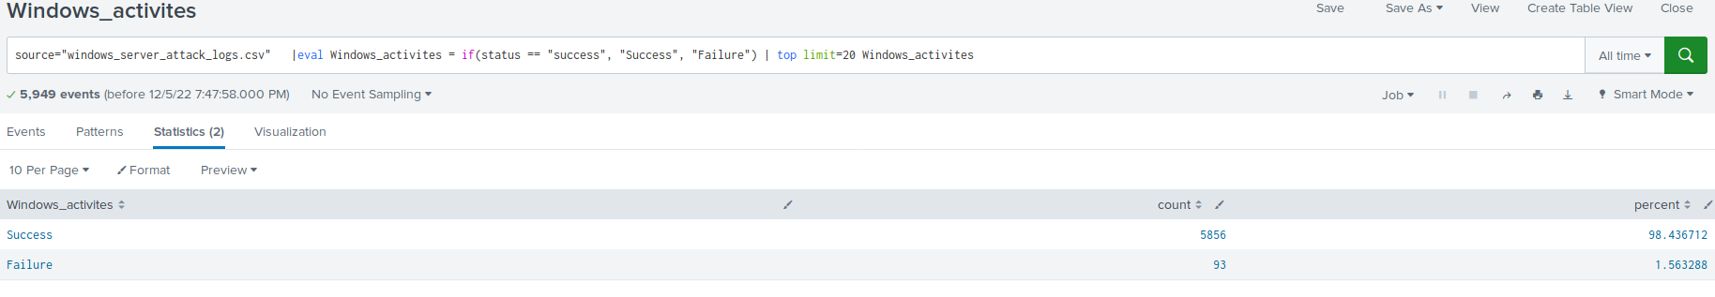
Images of Reports—Windows

Slide 16
Alerts—Windows
Designed the following alerts:
Alert Name | Alert Description | Alert Baseline | Alert Threshold
Above Average Windows Activity Failure | This alert is based on the amount of failed windows activity, mainly things like failed logins. | 10 or so failure in an hour is normal | Alert triggers at 13 failure in an hour, to make room for human error and trigger on abnormal activity levels
JUSTIFICATION: This alert exists to very early on notify of possible brute force attempts, or general attempts to password spray, the amount of failures in either case being high, would trigger the alert.

Slide 17
Alerts—Windows
Designed the following alerts:
Alert Name | Alert Description | Alert Baseline | Alert Threshold
Unusually High Logins | This alert monitors the amount of logins per an hour. | An average amount of hourly logins was 18-20 an hour | Therefore the threshold was set at 23 to make room for human error, but still trigger at a suspicious amount of traffic
JUSTIFICATION: This alert helps us see if an abnormal amount of accounts are being used or logged into in an hour to catch possible suspicious activity from compromised accounts.

Slide 18
Alerts—Windows
Designed the following alerts:
Alert Name | Alert Description | Alert Baseline | Alert Threshold
Above Average Account Deletion | This alert monitors the amount of deleted accounts in an hour | The baseline was set at around 20-22 an hour | The threshold therefore was set at 25, so that it would trigger around a suspicious increase in activity
JUSTIFICATION: This pairs well to the second alert, to either show that a malicious actor is using the compromised credentials to delete user accounts, or is making and deleting multiple accounts in an attempt to compromise the server.

Slide 19
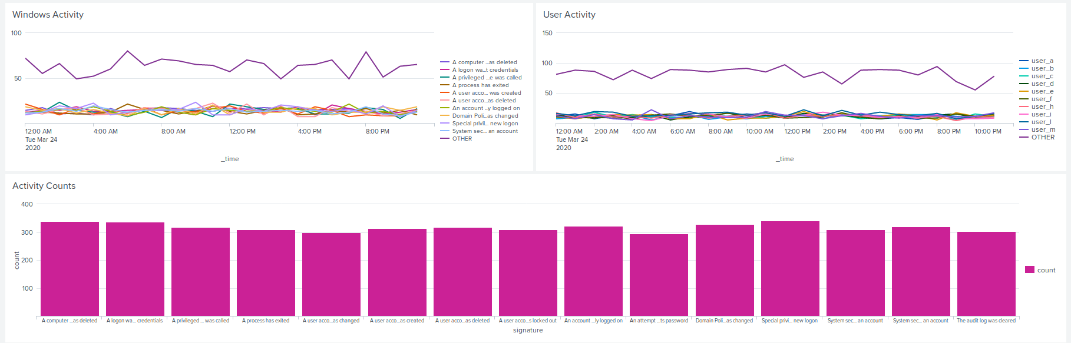
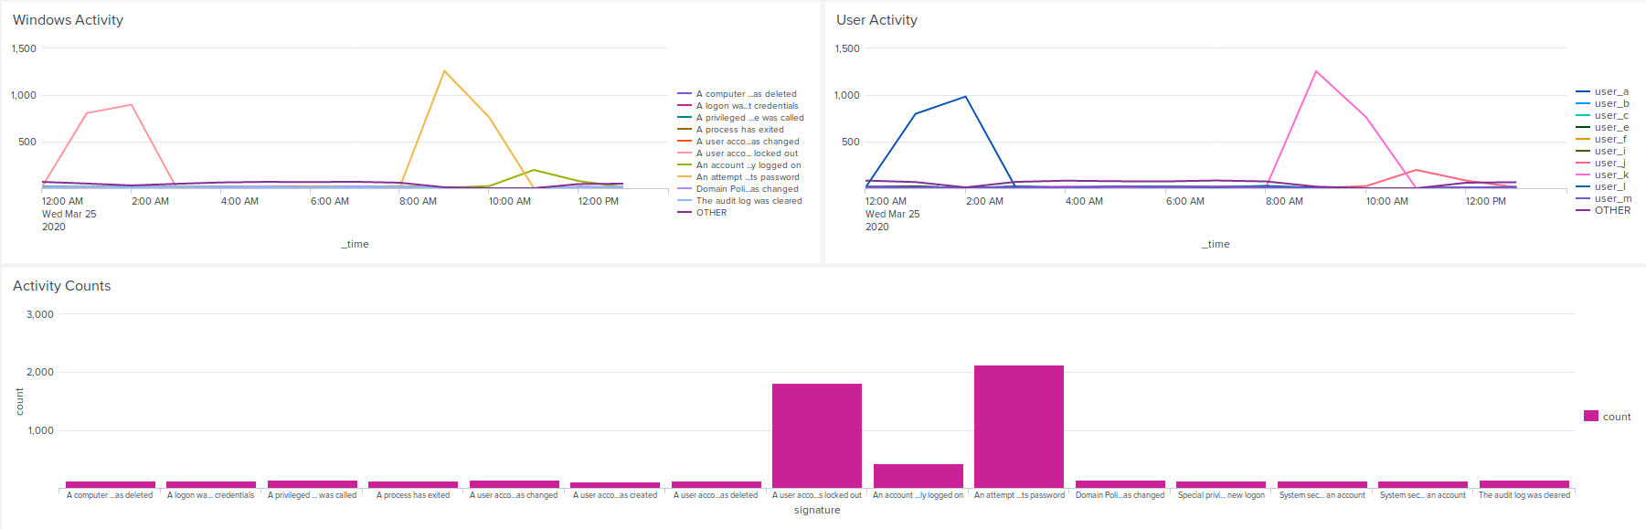
Dashboards—Windows
Baseline Logs
Attack Logs

Slide 20
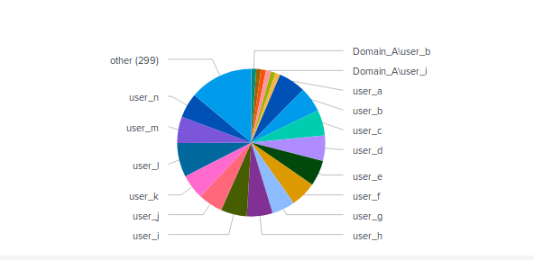
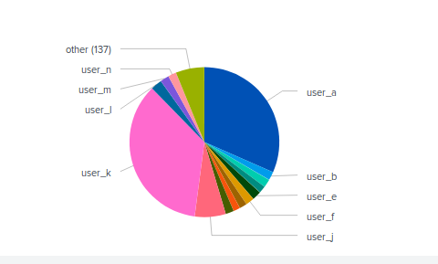
Dashboards—Windows
Baseline Logs
Attack Logs

Slide 21
Apache Logs
‹#›

Slide 22
Reports—Apache
Report Name | Report Description
Apache_Logs, Table 1 | HTTP Request Method, Domain, Status, clientip, and the relating useragent
Apache_Logs, HTTP Request Methods per hour | Count of GET, POST, HEAD and OPTIONS request per hour
Apache_Logs, Total Count by Country | Stats of traffic per Country
Apache_Logs, Top Ten Domains | Count and Percentage of Top Ten Domains on VSI Server

Slide 23
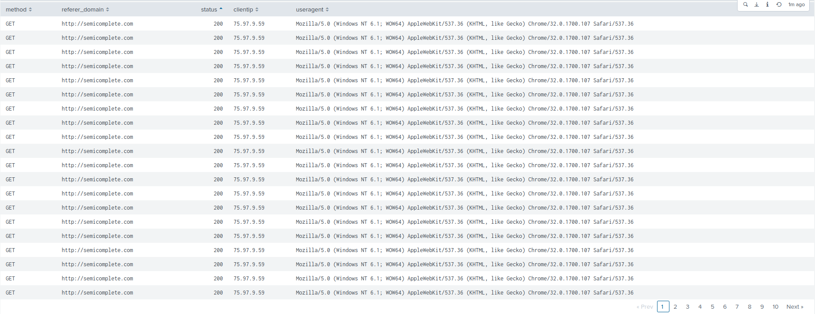
Images of Reports-Apache
Apache_Logs, Table 1

Slide 24
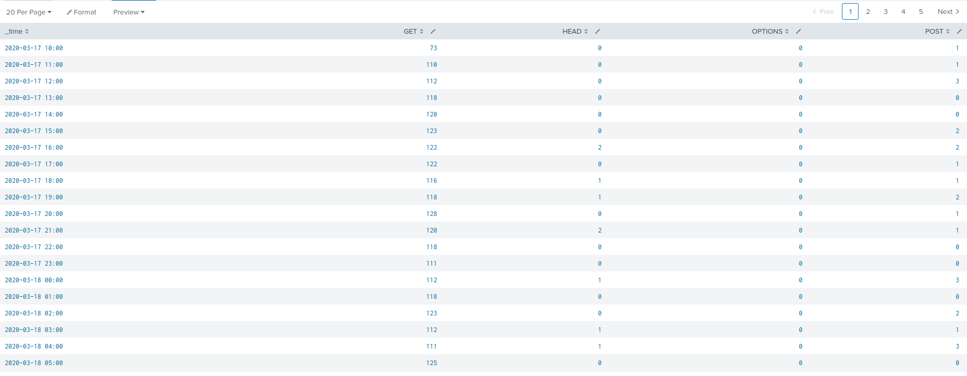
Images of Reports-Apache
Apache_Logs, HTTP REQUEST METHODS per hour

Slide 25
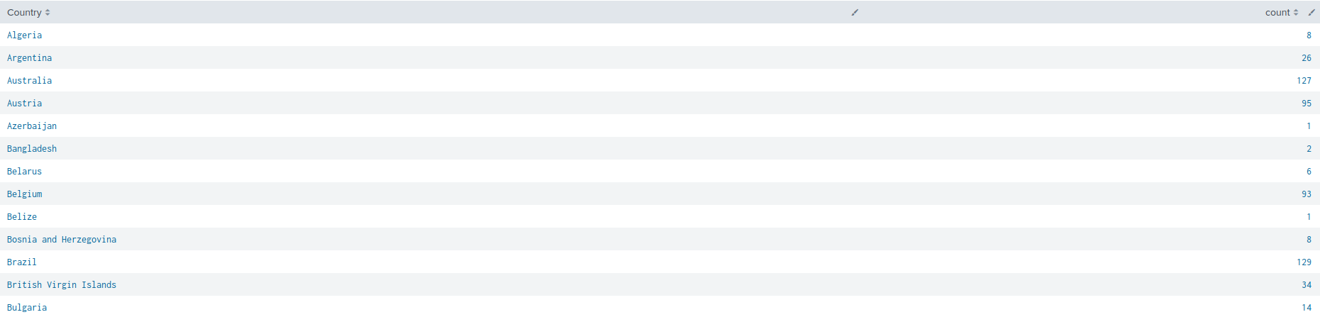
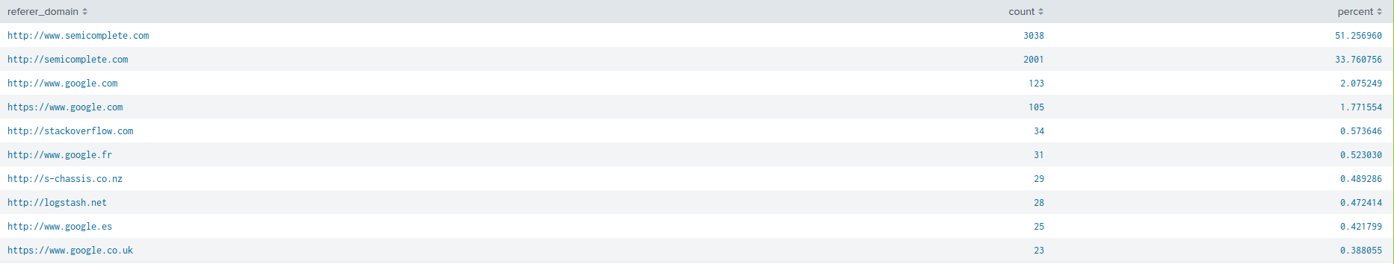
Images of Reports-Apache
Apache_Logs, Total Count by Country
Apache_Logs, Top Ten Domains

Slide 26
Alerts—Apache
Alert: Country Location is not United States
Alert Name | Alert Description | Alert Baseline | Alert Threshold
Country Location is not United States | iplocation based on clientip is not United States | iplocation not United States | when clientip iplocation is not in the United States send stats to SOC@VSI-company.com
JUSTIFICATION: Regular usage from VSI administrative locations are in the United States. The rumors of JobeCorp launching cyber attacks to disrupt VSI business will come from outside of our known location

Slide 27
Alerts—Apache
Alert: GET & POST Request per hour
Alert Name | Alert Description | Alert Baseline | Alert Threshold
GET Request has exceeded baseline | GET Request per hour has exceeded established baseline | 73 - 130 GET Request per hour | 140 GET Request per hour
POST Request has exceeded baseline | POST Request per hour has exceeded established baseline | 0 - 7 POST Request per hour | 10 Request per hour
JUSTIFICATION: Threshold is set to avoid false negatives and alert our SOC team that irregular activity is happening on our Apache Server

Slide 28
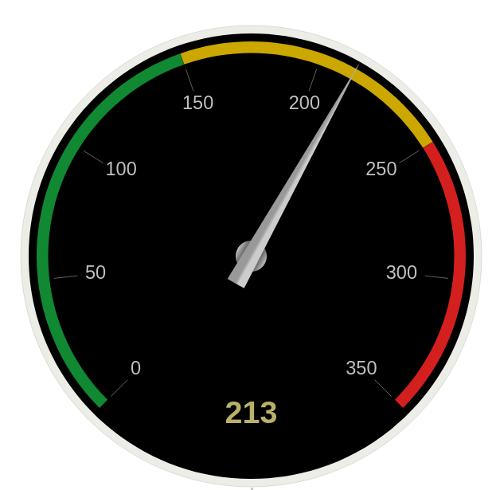
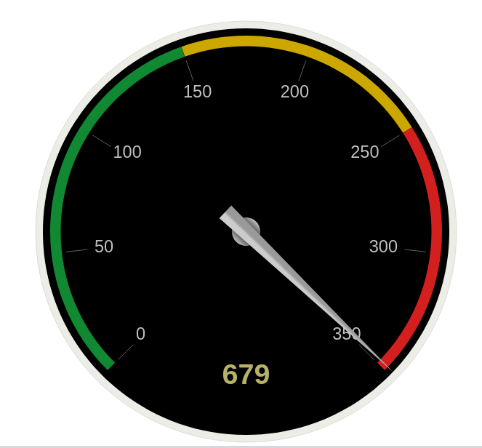
Dashboard-Apache
404 STATUS TOTAL During Regular Activity
404 STATUS TOTAL During Attack Activity

Slide 29
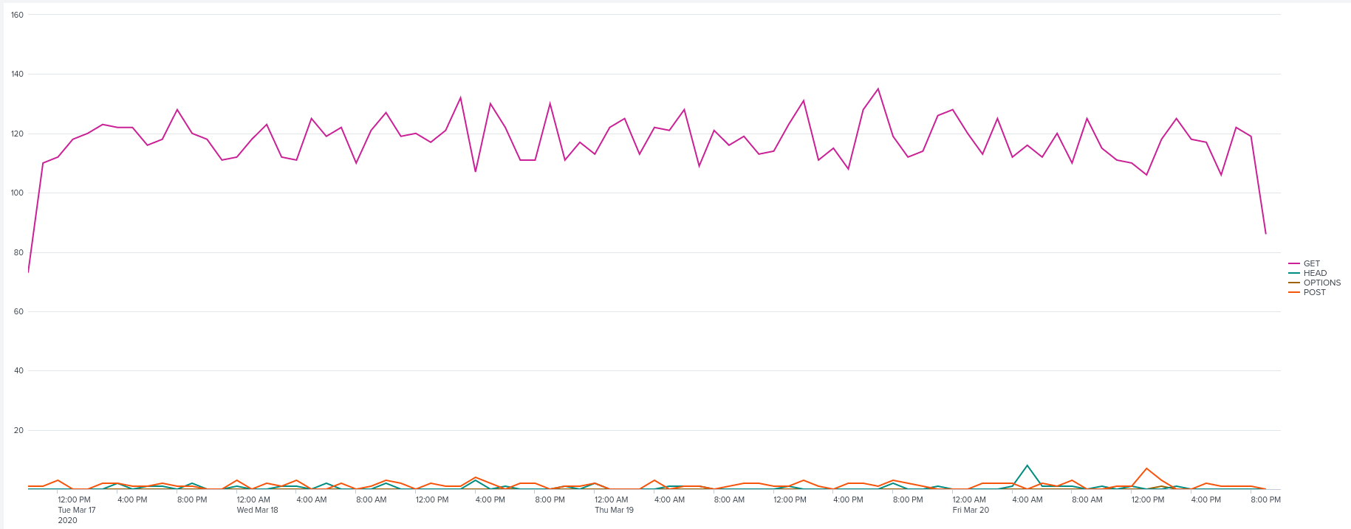
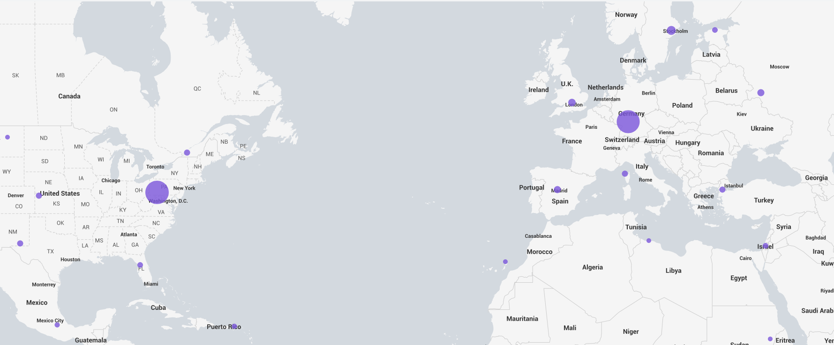
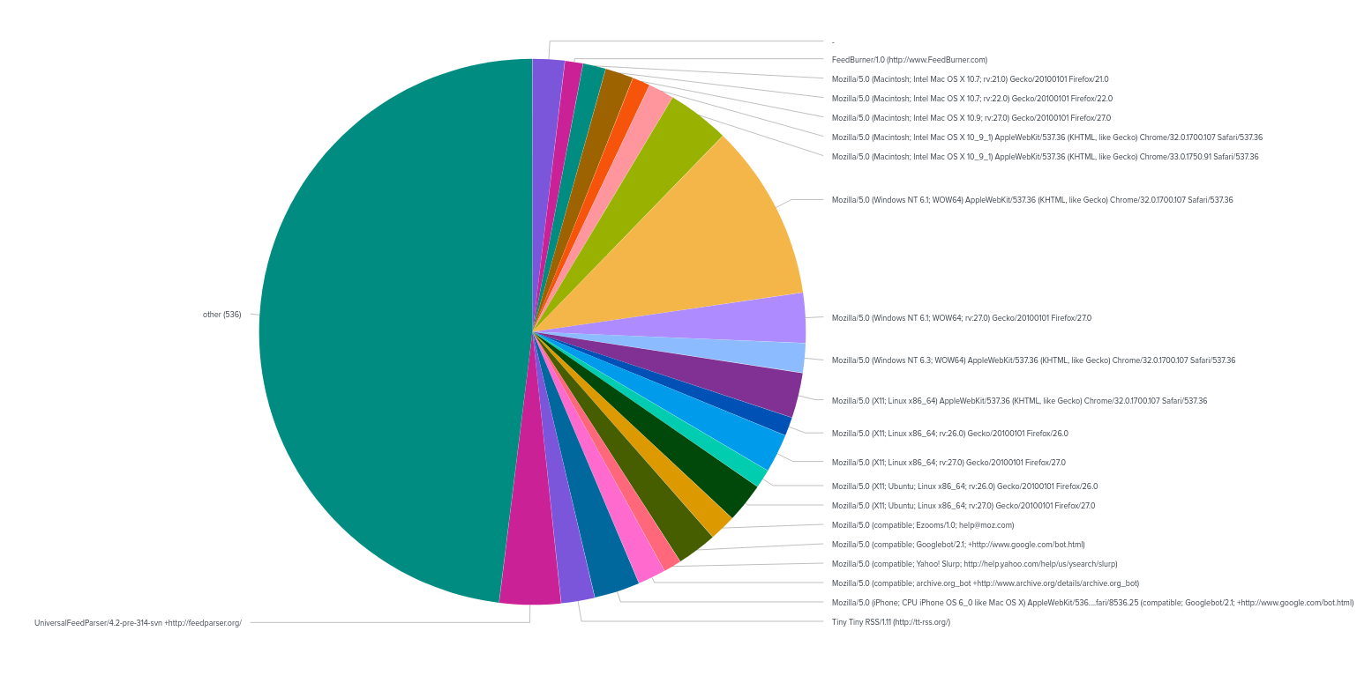
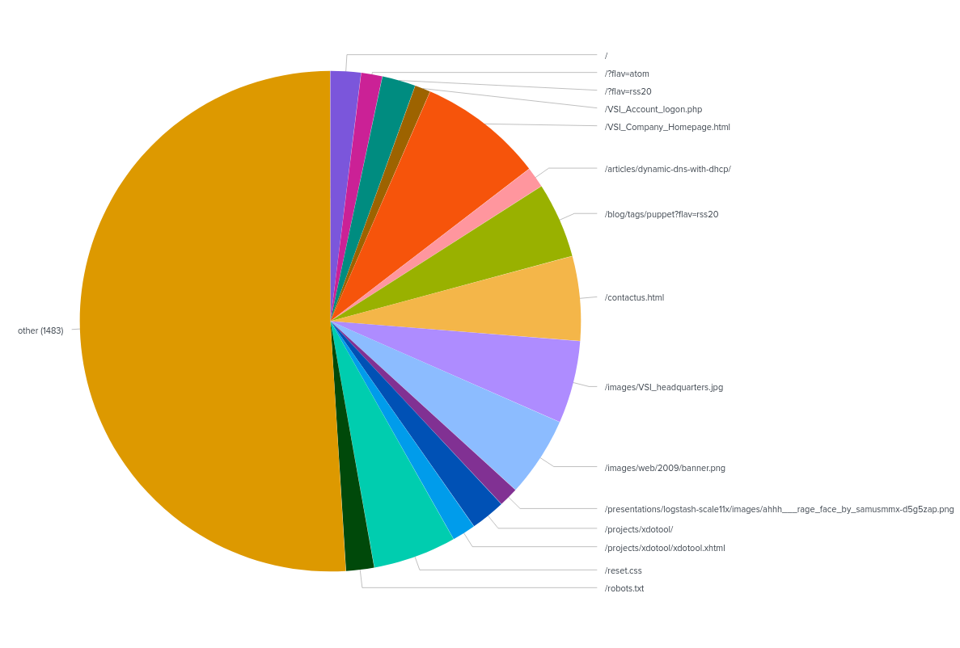
Dashboard-Apache
HTTP REQUEST METHODS
GEOGRAPHICAL MAP
USERAGENT
URI

Slide 30
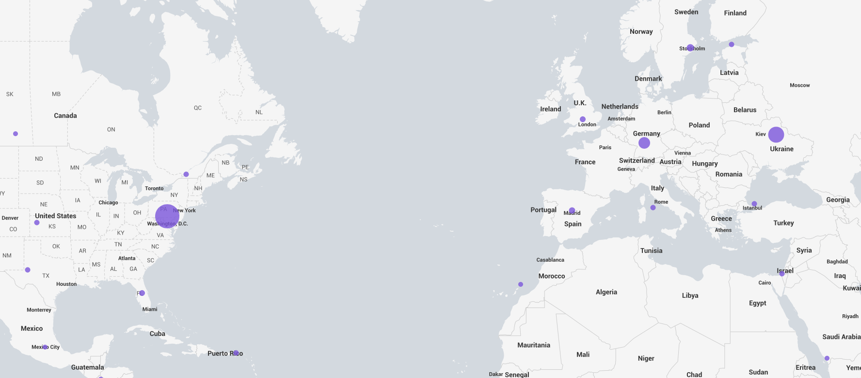
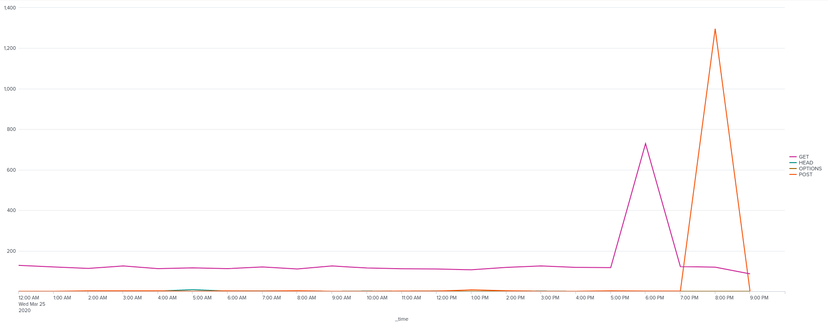
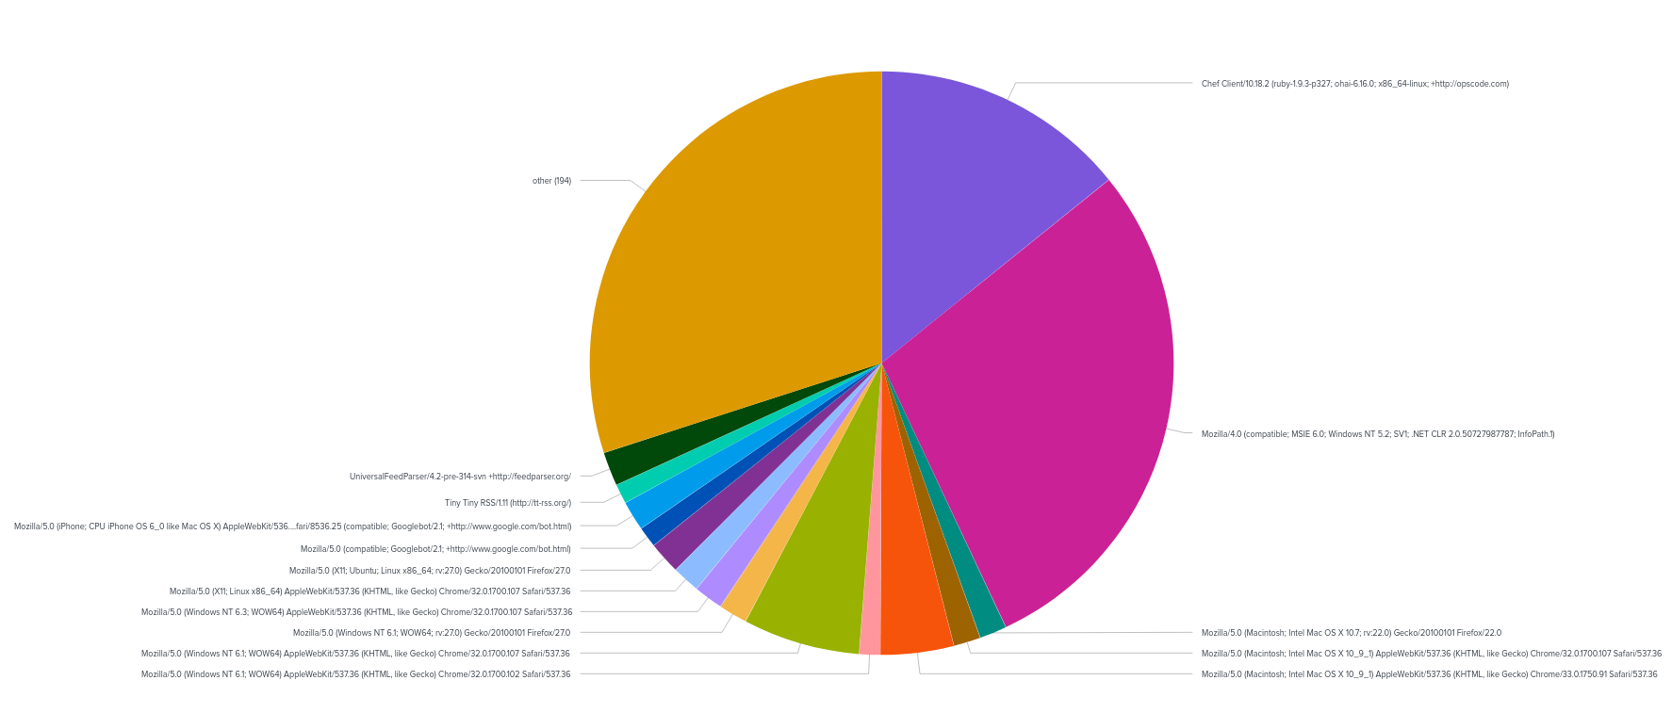
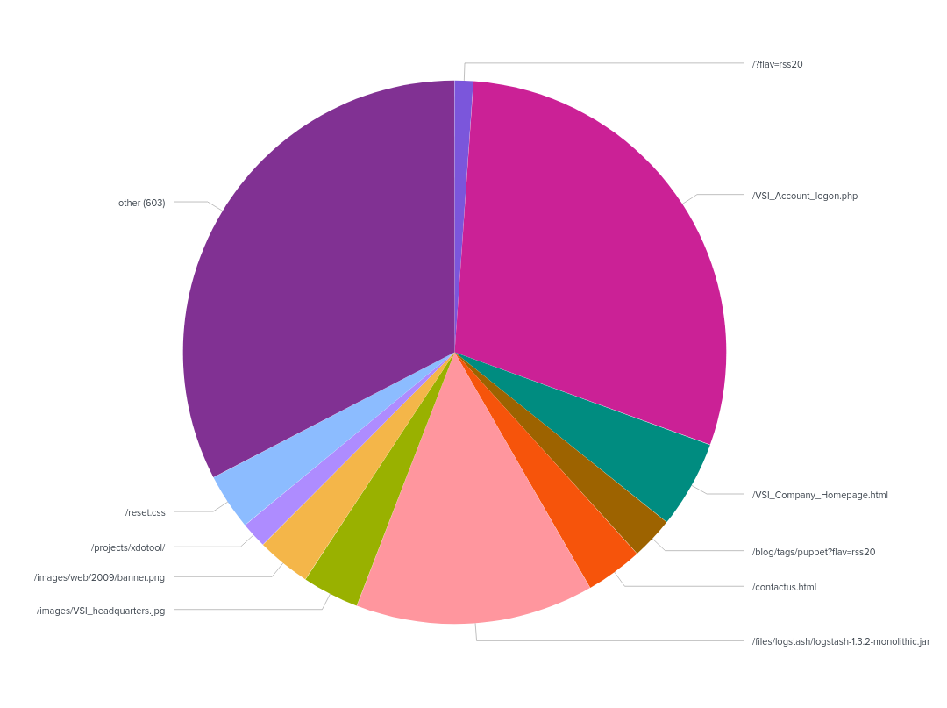
Dashboards—Apache
HTTP REQUEST METHODS
GEOGRAPHICAL MAP
USERAGENT
URI

Slide 31
Attack Analysis
‹#›

Slide 32
Attack Summary—Windows
At 2AM on March 25, 2020 there were 94 events labeled “account successfully logged on”.
At 8AM there was a significant increase of failed attempts (35 compared to at most 8 in other hours).
At 9AM March 25, 2020 there were 70 successfully logged on. The highest up until that point was 25.
At 8PM there was a significant increase in Post requests (1,296, the next closest was 7).
Our thresholds were accurate and do not need any adjusting at this time.

Slide 33
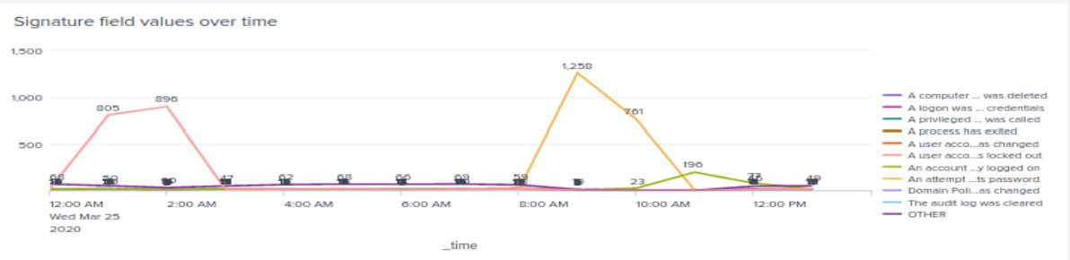
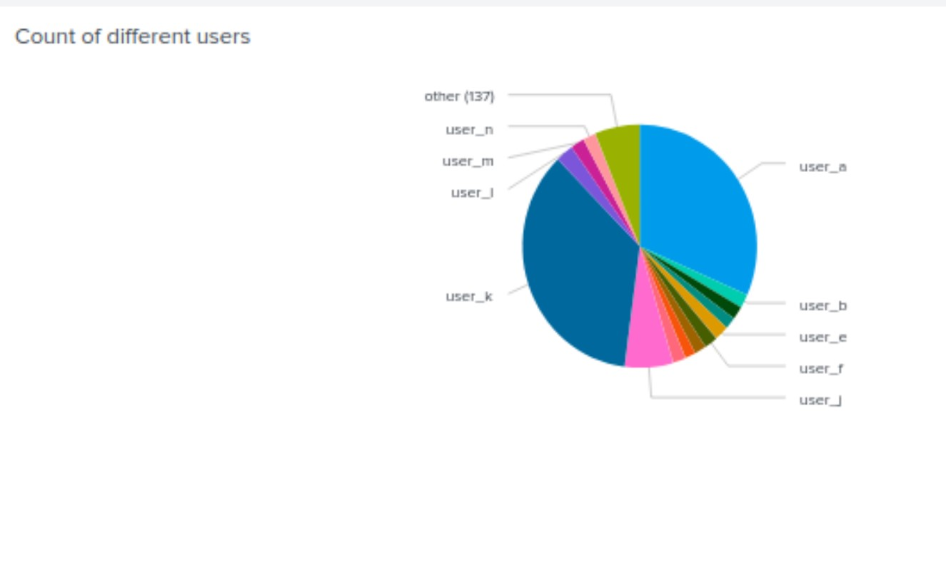
Attack Summary—Windows
From 1-2AM on March 25, 2020 user_a experienced a brute force attack which resulted in user being locked out
At 9AM on March 25, 2020 user_k was compromised with repeated attempts to reset user account password.
Attempt to reset password
User Account Locked Out
Account Successfully Logged on

Slide 34
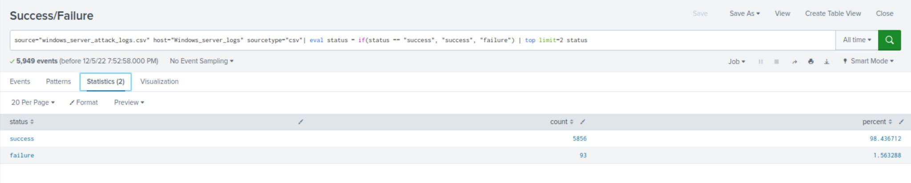
Attack Summary—Windows
Based on IP location the spike in requests are coming from Ukraine
From the response code (200) they were successful in gaining access.
With a count of 5,856 the success rate is just above 98%

Slide 35
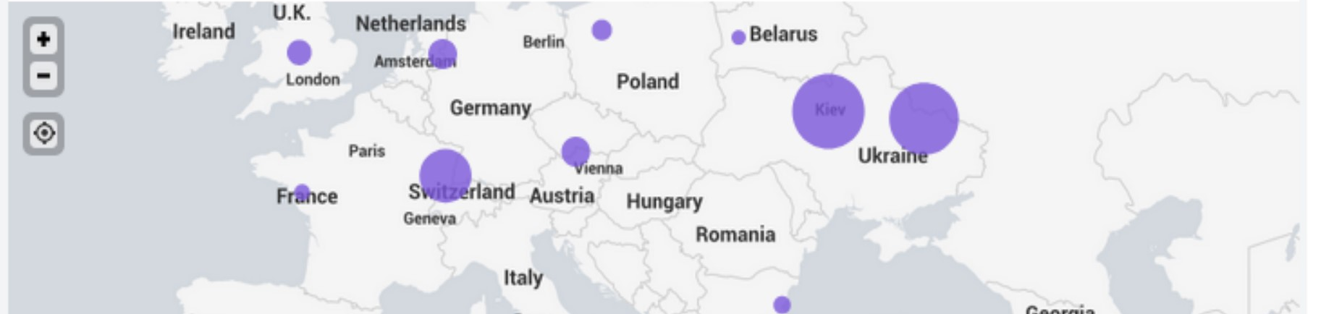
Attack Summary—Apache
Ukraine showed a spike in activity from the attack logs
Coming from Kiev and Kharkiv regions
VSI_Account_logon.php had large increase in activity at 8PM March 25, 2020
This appears to be a brute force attack targeting the VSI Apache servers possibly using code injection to gain access to the VSI-Account_Logon site.

Slide 36
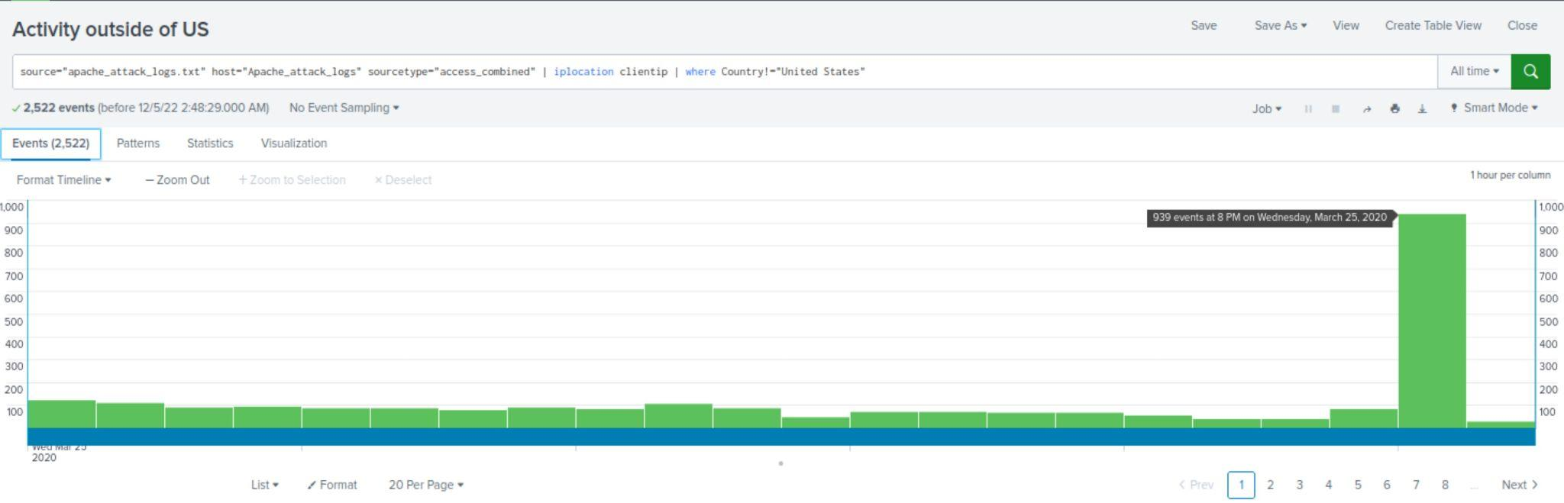
Attack Summary—Apache
From 8PM to 9PM on March 25, 2020 there was a large spike in traffic from outside the US.
Typically we see up to 120 events, this time it was 939.

Slide 37
Attack Summary—Apache
During the 6PM hour on March 25, 2020 there was a spike in ‘GET’ requests.
At this point the bad actors were targeting the logstash, possibly to find credentials for logging in.
As soon as that dropped off there was a spike in ‘POST’ request during the 8PM hour.
This spike was targeting the VSI-Account_Logon.php site.
This appears to be a brute force attack using code injection to gain access.

Slide 38
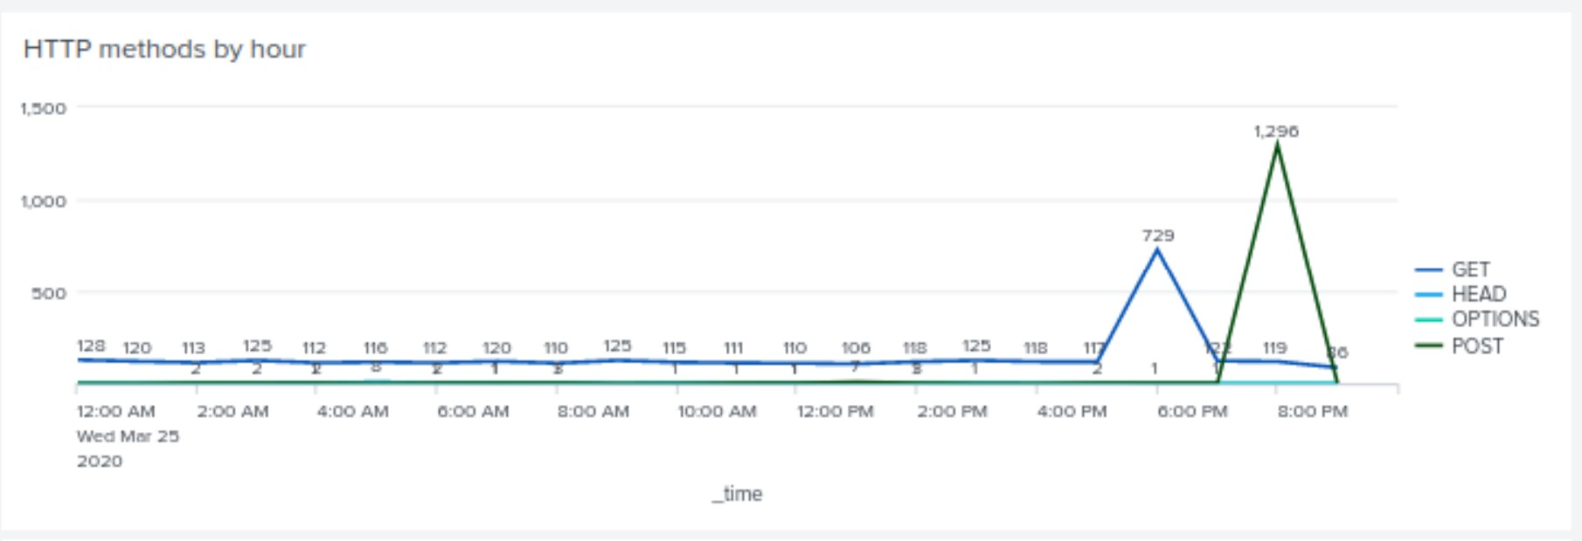
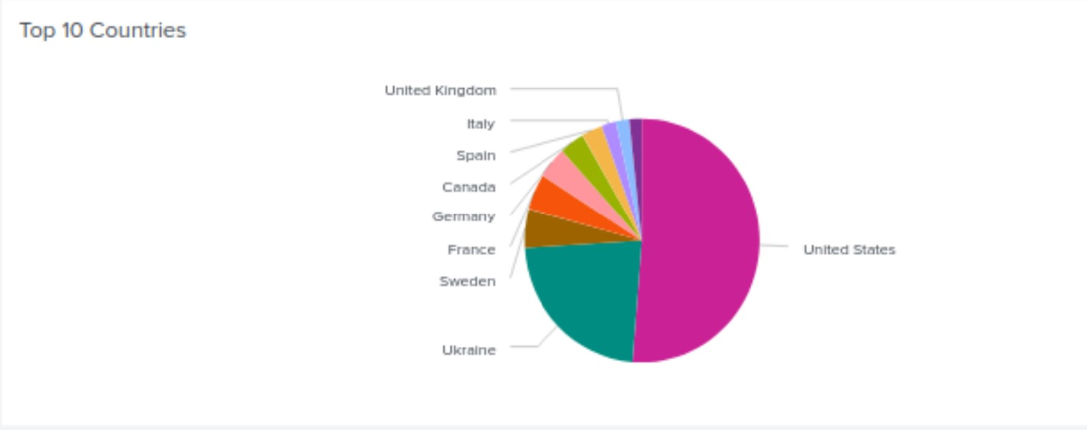
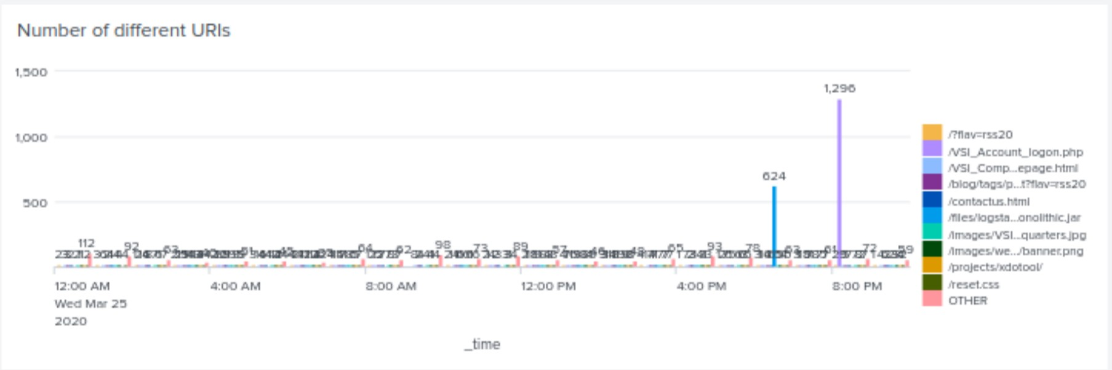
Screenshots of Attack Logs
Top 10 Countries after attack
VSI_Account_Logon POST requests
Stashlogs GET request

Slide 39
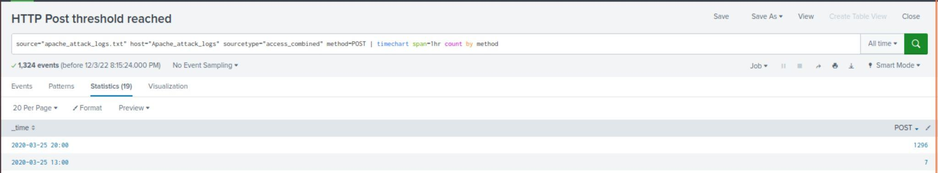
Screenshots of Attack Logs
HTTP Post requests after attack
8 PM on March 25, 2020
Second highest Post request

Slide 40
Summary and Future Mitigations
‹#›

Slide 41
Project 3 Summary
What were your overall findings from the attack that took place?
Brute force was used to attack the OS as seen through repeated attempts of both password resets and logon attempts.
SQL injections were used as means of attacking the Apache server
To protect VSI from future attacks, what future mitigations would you recommend?
On the Windows side a quick mitigation action would be to reduce the allowed number of attempts for both login and passwords resets thus improving our firms Rapid Time to Action.
For the Apache Server, put in place a custom WAF rules, update and patch server early and when needed, but above all ensure sanitize and validate code to remove dangerous characters

